Slide 1
Introduction To Hadoop

Slide 2
Agenda
What is Big Data
What Comes under Big Data
Big Data Characteristics
Big Data Challenges
Brief History
Hadoop Core Components
Hadoop 1.x Architecture

Slide 3
Agenda
Hadoop 1.x Limitations
Hadoop 2.x Architecture
Map Reduce VS YARN
Summary

Slide 4
What is Big Data
Big Data is a collection of large datasets that cannot be processed using traditional computing techniques.
Data that would take too much time and cost too much money to load into a relational database for analysis
Big data doesn’t refer to specific quantity, the term is often used when speaking about terabytes ,petabytes and exabytes of data
Notes:
Data that is beyond to storage capacity and beyond to the processing power

Slide 5
What Comes under Big Data
Social Media Data
CCTV Data
Stock Exchange Data
Search Engine Data
Sensors Data
Online Shopping Data
And many more
Notes:
90% of the world’s data was generated in the last few years

Slide 6
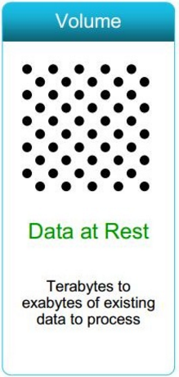
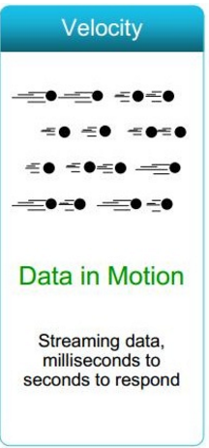
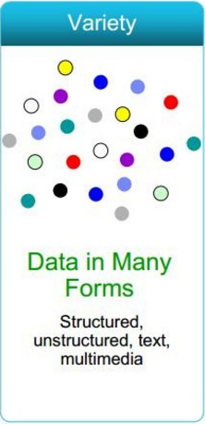
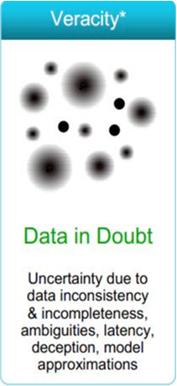
Big Data Characteristics (4 Vs)
Notes:
Volume: For data to be referred as big data, generally the volume of data is massive
Velocity: For data to be referred as big data, the rate at which data comes into system is really fast.
Data speed -Sometimes 2 minutes is too late. For time critical applications where Time is the core factor such that catching the frauds, catching the hackers, running status of train, big data must be used as it streams into your enterprise in order to maximize its value. Not only is the volume of data large, it is arriving ever more rapidly. Example: Scrutinize 5 million trade events created each day to identify potential fraud Analyze 500 million daily call detail records in real-time to predict customer churn faster "machine data" generated on the factory floor or trading data generated by financial markets.
Variety: For data to be referred as big data ,generally the data would be both structured and unstructured data and may be originated from variety of sources such as text, sensor data, audio, video, click streams, log files and more. New insights are found when analyzing these data types together. Example: Monitor 100's of live video feeds from surveillance cameras to target points of interest Exploit the 80% data growth in images, video and documents to improve customer satisfaction.

Slide 7
Big Data Challenges
How To Store Big Data
How to store big data beyond capacity of disk space
How To Process Big Data
How to Process and extract valuable information from huge amount of data within given time?
Solution…
HADOOP
Notes:
Storage – In Traditional approach data were store under RDBMS or data warehouses managed by Data Centers under high reliable systems
Processing – Fetch data from Data Centers and apply client program to process the data

Slide 8
Brief History
Google
2003
Published white paper on Google File System – Distributed File System
2004
Published white paper on Map Reduce –
Distributed Processing

Slide 9




Brief History
2005: Using the solution provided by Google ,Doug Cutting developed an open source project Hadoop
The project was funded by Yahoo.
2006: Yahoo gave the project to Apache Software Foundation.
Doug Cutting
Distributed file system – GFS
Distributed Processing– Map Reduce

Slide 10
Hadoop Core Component
Hadoop Distributed File System
HDFS is a file system designed for storing very large files with streaming data access patterns, running on clusters of commodity hardware.
Map Reduce
MapReduce is a Distributed Data Processing or Batch Processing Programming Model.
Like HDFS, MapReduce component also uses Commodity Hardware to process “High Volume of Variety of Data at High Velocity Rate” in a reliable and fault-tolerant manner.
Hadoop has a master/slave architecture both storage and processing
Notes:
Cluster - Group of independent servers (usually in close proximity to one another) interconnected through a dedicated network to work as one centralized data processing resource.

Slide 11
HDFS – Master Services
Name Node:
Stores metadata for the files in memory, like the directory structure , permission, ownership, last modified time etc.,These information also stored into disk for persistence storage.
The server holding the NameNode instance is quite crucial, as it is Single point of Failure.
Handles creation of more replica blocks when necessary after a Data Node failure
Secondary Name Node:
One misinterpretation from name is “This is a backup Name Node” but IT IS NOT!!!!!
SNN is responsible for performing periodic checkpoints. So in the event of Name node failure, we can restart name node using the check point
Notes:
SNN - It manages the metadata for the Name Node. In the sense, it reads the information written in edit logs (by Name Node) and creates an updated file of current cluster

Slide 12
HDFS – Slave Service
Data Node:
There are many instances of this process running on various slave nodes(referred as Data nodes)
It is responsible for storing the individual file blocks on the slave nodes in Hadoop cluster
Based on the replication factor, a single block is replicated in multiple slave nodes to prevent the data loss
This process periodically sends heart beat to Name Node to make Name Node aware that slave process is running
Send block reports to Name Node.

Slide 13
HDFS Configuration files
core-site.xml
Name Node address (fs.defaultFS )
hdfs-site.xml
Block size (dfs.blocksize)
Replication factor (dfs.replication)
Name node directory (dfs.namenode.name.dir)
Data node directory (dfs.datanode.data.dir)

Slide 14
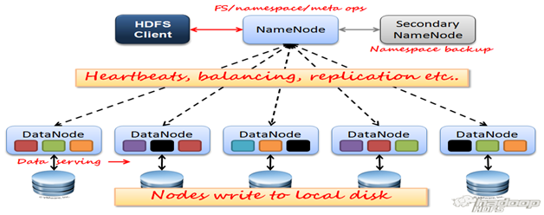
HDFS 1.x Architecture

Slide 15
Map Reduce
The term MapReduce actually refers to two separate and distinct tasks that Hadoop programs perform.
A MapReduce job usually splits the input data-set into independent chunks which are processed by the map tasks in a completely parallel manner.
Map Task converts the data into another set of data, where individual elements are broken down into tuples (key/value pairs).
The reduce job takes the output from a map as input and combines those data tuples into a smaller set of tuples.
The reduce job is always performed after the map job.

Slide 16
Map Reduce – Master Service
Job Tracker:
Only one instance of this process runs on a master node same as Name Node
Any MapReduce job is submitted to Job Tracker first
Job Tracker checks for the location various file blocks used in MapReduce processing
It initiates the separate tasks on various Data Nodes(where blocks are present) by communicating with Task Tracker Daemons
It does resource management, job scheduling, job management and log management

Slide 17
Map Reduce – Slave Service
Task Tracker:
This process has multiple instances running on the slave nodes
It receives the job information from Job Tracker daemon and initiates a task on that slave node
They are responsible for running the map and reduce tasks as instructed by Job tracker
In most of the cases, Task Tracker initiates the task on the same node where there physical data block is present
Same as Data Node daemon, this process also periodically sends heart beats to Job Tracker to make Job Tracker aware that slave process is running

Slide 18
Mapreduce Configuration file
mapred-site.xml
mapred.job.tracker
mapred.job.tracker.http.address
mapred.tasktracker.map.tasks.maximum
mapred.tasktracker.reduce.tasks.maximum
Notes:
mapred.job.tracker -- <ip_address>:8021 -- Job Tracker ip address and port number
mapred.job.tracker.http.address -- <ip_address>:50030 -- Job tracker web UI ip address and port number
mapred.tasktracker.map.tasks.maximum -- Maximum Map slots per task tracker
mapred.tasktracker.reduce.tasks.maximum -- Maximum Reduce slots per task tracker

Slide 19
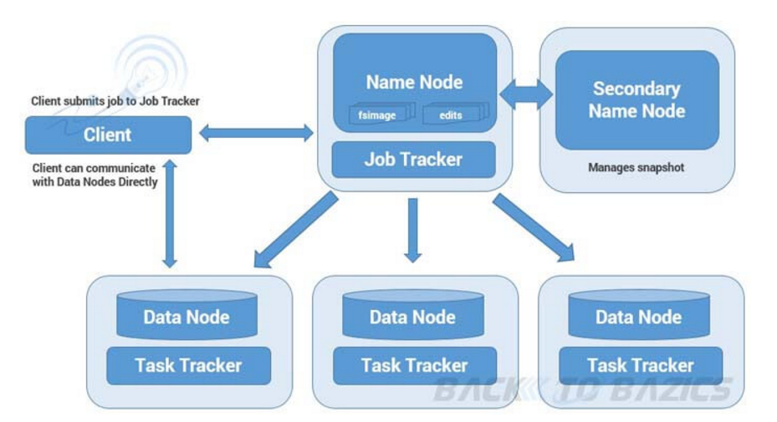
Map Reduce Architecture

Slide 20
Map Reduce Word Count Process…
Input file (sample.txt - 500MB)
Block Size-128 MB
…
hadoop mapreduce yarn hdfs
hadoop yarn hive pig
pig hadoop hdfs
hdfs hadoop mapreduce
yarn pig hdfs
hadoop hive spark yarn
spark hdfs hadoop
mapreduce hadoop
Split1
Split2
Split3
Split4
128MB
Record Reader
Record Reader
Record Reader
Record Reader
128MB
(0, hadoop mapreduce yarn hdfs)
(27, hadoop yarn hive pig)
(48,pig hadoop hdfs)
(64, hdfs hadoop mapreduce)
(86,yarn pig hdfs )
(100, hadoop hive spark yarn)
(123, spark hdfs hadoop)
(141, mapreduce hadoop)
128MB
Mapper
Mapper
Mapper
Mapper
116MB
(hadoop,1)
(mapreduce,1)
(yarn,1)
(hdfs,1)
(hadoop,1)
(yarn,1)
(hive,1)
(pig,1)
(pig,1)
(hadoop,1)
(hdfs,1)
(hdfs,1)
(hadoop,1)
(mapreduce,1)
(yarn,1)
(pig,1)
(hdfs,1)
(hadoop,1)
(hive,1)
(spark,1)
(yarn,1)
(spark,1)
(hdfs,1)
(hadoop,1)
(mapreduce,1)
(hadoop,1)
(hadoop,[1,1,1,1,1,1,1]) (hdfs,[1,1,1,1,1]) (hive,[1,1]) (mapreduce,[1,1,1]) (pig,[1,1,1]) (spark,[1,1]) (yarn,[1,1,1,1])
Shuffle & Sort
(hadoop,7) (hdfs,5) (hive,2) (mapreduce,3) (pig,3) (spark,2) (yarn,4)
Reducer
Hadoop 7
Hdfs 5
Mapreduce 3
Spark 2
Yarn 4
Record Writer
Output File
Notes:
Problem Statement – Count the occurrence of the each word in the given file and store the output in output directory

Slide 21
Hadoop 1.x Limitations
Major drawback of Hadoop 1.x Architecture is Single Point of Failure as there is no backup Name Node.
Job scheduling, resource management and job monitoring are being done by single Job Tracker.
Under utilization of resources as mappers and reducers are pre-configured
Tightly coupled with Map reduce job
Notes:
In MR1 ,scalability is bottleneck when cluster size grows 4000+ as only one job tracker doing multiple tasks

Slide 22
Hadoop 2.x HA Components
HDFS HA – Quorum cluster components
Active and Standby Namenodes
HA is different than Secondary namenode or Federation
Only one node will be active
Standby node will get edit logs at regular intervals from journal nodes (journal nodes get edit logs from active nodes)
Shared edits
Shared Storage
Uses NFS to store edit logs in shared location by both Namenodes (Active and Standby)
Active Namenode writes to shared edit logs
Passive Namenode reads from shared edit logs and apply
Journal Nodes (Journal directories)
Typically 3 (when greater than 3 it needs to be odd number)
Active namenode will write edit logs to majority of the configured journal nodes
Standby namenode will read edit logs from any of the surviving journal node
Zookeeper (quorum)
It will be running on typically 3 or 5 nodes
ZKFC – Light weight Service running on both Name Nodes
Notes:
NFS – Network File System

Slide 23
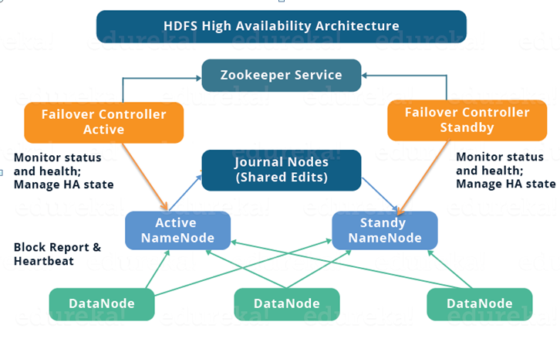
Hadoop 2.x HA Architecture

Slide 24
YARN/MR2
YARN – Yet Another Resource Negotiator
A generic job management tool which can share resources between "map reduce" based distributed processing tools as well as "non map reduce" based distributed processing tools.
Daemon Processes
Master -> Resource Manager
Slave(s) -> Node Managers
Apptimeline server (application history)
History server (Map Reduce history)
Per job Application Master
Parameter Files
yarn-site.xml
mapred-site.xml
Apache Web Interfaces
Resource Manager WUI
Application Master WUI
Job History Server

Slide 25
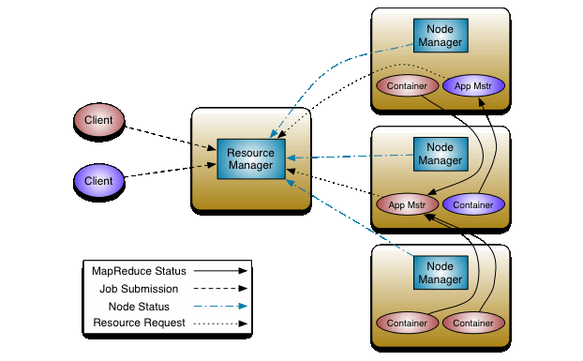
YARN Architecture

Slide 26
MR1 VS MR2
Slaves (Datanodes and Tasktrackers)
Hadoop Cluster – Processing (MRv1/Classic)
Two data sets
One with 2 files/blocks
Another with 4 files/blocks
M
Job Tracker
R
Gateway
1
M
Job is submitted to process the data
Request have gone to job tracker
Job submitted and monitored
2 map tasks are created where data is stored (data locality)
Map tasks are created to read data from HDFS and perform row level transformations
1 reduce task is created to aggregate the data

Slide 27
MR1 VS MR2
Slaves (Datanodes and Tasktrackers)
Hadoop Cluster – Processing (MRv1/Classic)
M
M
R
Job Tracker
M
Gateway
1
2
M
M
One job is running
Job tracker will perform both resource management and monitors job management of all jobs
Second job is submitted
R
M

Slide 28
MR1 VS MR2
Slaves (Datanodes and nodemanagers)
Hadoop Cluster – Processing (MRv2 + YARN)
Two data sets
One with 2 files/blocks
Another with 4 files/blocks
M
Resource Manager
R
Gateway
1
M
Job is submitted to process the data
Request have gone to resource manager
First application master will be created
Application master will determine which nodes map and reduce tasks should be executed in “containers”
Application master will take care of job management (unlike classic where job tracker does job management)
AM

Slide 29
MR1 VS MR2
Slaves (Datanodes and nodemanagers)
M
AM
Hadoop Cluster – Processing (MRv2 + YARN)
Two data sets
One with 2 files/blocks
Another with 4 files/blocks
M
Resource Manager
R
Gateway
M
1
2
R
M
M
One job is running
Second job is submitted
Resource Manager will perform resource management while Job management take cares by Application specific Application Master
AM
M

Slide 30
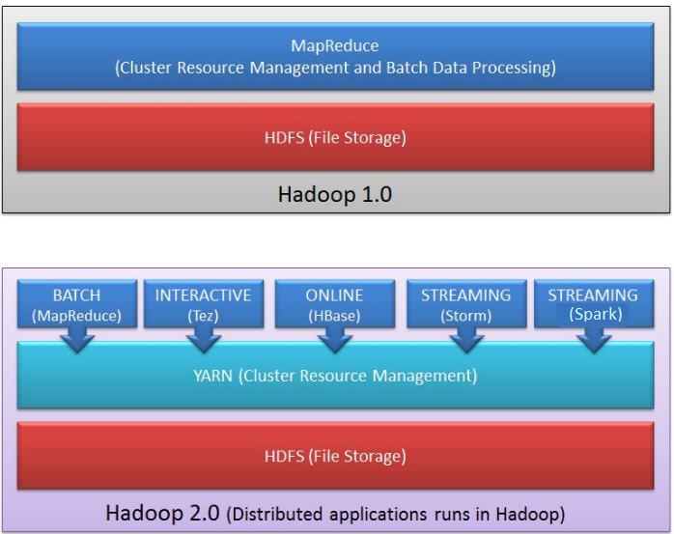
Hadoop 1 VS Hadoop 2

Slide 31
MR1 Vs MR2 - Summary
 | MRv1/Classic | MRv2/YARN
Master | Job Tracker – handles both resource management as well as job processing. | Resource Manager – only looks after resource management.
Slave on each datanode | Task Tracker | Node Manager
Job | Job Tracker controls life cycle of the job | Per job application master controls life cycle of job. Application master is transient in nature and will be cleaned up after job is completed.
Mappers and reducers | Task tracker will manage the processes that runs tasks (mappers and reducers) | Containers will manage the processes that runs tasks (mappers and reducers). Containers are transient in nature and will be cleaned up when job is completed.
Mappers and reducers | Tasks for mappers and reducers on each node are pre-configured and cannot be changed. It can cause under utilization of resources. | Tasks for mappers and reducers are not pre-configured. Relatively effective utilization of resources.
Scalability | Single point of failure and probability is high as Job Tracker controls each job life cycle as well as resource consumption. Have issues with clusters more than 4000 nodes | Can configure for high availability. Resource Manager is relatively stable than Job tracker.

Slide 32
Hadoop Distributions
Hadoop
Hive
Monitoring
Sqoop
Many more
Hortonworks
Cloudera
MapR
HDInsight
BigInsight
EMR

Slide 33
Few More Terms
Big Data Ingestion
The process of importing, transferring, loading and processing data for later use or storage in a database is called Data ingestion
Data can be streamed in real time or ingested in batches
Tools…
Apache Flume
Gobblin
Apache Sqoop
Amazon Kinesis
Apache Kafka
Apache Samza
Apache Storm
Apache NIFI
Cloudera Morphlines

Slide 34
Few More Terms
Big Data Analytics
Big data analytics is the process of examining large data sets to uncover hidden patterns, unknown correlations, market trends, customer preferences and other useful business information.
Tools …
Hive
Pig
Impala
Google BigQuery
Splunk Bigdata Analytics

Slide 35
Few More Terms
Big Data Visualization
Data visualization is the presentation of data in a pictorial or graphical format. It enables decision makers to see analytics presented visually, so they can grasp difficult concepts or identify new patterns.
Tools …
Tableau
Power BI
D3
Kibana
Amazon Quicksight
Google Chart

Slide 36
Quiz Time
What does “Velocity” in Big Data?
Speed of input data generation
Speed of individual machine processors
Speed of ONLY storing data
Speed of storing and processing data
When a client contacts the namenode for accessing a file, the namenode responds with?
Size of the file requested
Block ID of the file requested
Block ID and hostname of any one of the data nodes containing that block.
Block ID and hostname of all the data nodes containing that block.

Slide 37
Quiz Time
Which of the following is/are correct?
NameNode is the SPOF (Single point of Failure) in Hadoop 1.x
NameNode is the SPOF in Hadoop 2.x
NameNode keeps the image of the file system
Both (a) and (c)
A file in HDFS that is smaller than a single block size
Cannot be stored in HDFS
Occupies the full block's size
Occupies only the size it needs and not the full block
an span over multiple blocks

Slide 38
Quiz Time
The Zookeeper
Detects the failure of the namenode and elects a new namenode.
Detects the failure of datanodes and elects a new datanode.
Prevents the hardware from overheating by shutting them down.
Maintains a list of all the components IP address of the Hadoop cluster.
The role of a Journal node is to?
Report the location of the blocks in a data node
Report the edit log information of the blocks in the data node
Report the Schedules when the jobs are going to run
Report the activity of various components handled by resource manager

Slide 39
Any Questions?

Slide 40
Thank you!

Slide 41
HDFS - Important parameters
File Name | Parameter Name | Parameter value | Description
core-site.xml | fs.defaultFS/fs.default.name | hdfs://<namenode_ip>:8020 | Namenode ip address or nameservice (HA config)
hdfs-site.xml | dfs.block.size, dfs.blocksize | 128 MB | Block size at which files will be stored physically.
hdfs-site.xml | dfs.replication | 3 | Number of copies per block of a file for fault tolerance
hdfs-site.xml | dfs.namenode.http-address | 0.0.0.0:50070 | Namenode Web UI. By default it might use IP address of namenode.
hdfs-site.xml | dfs.datanode.http.address | 0.0.0.0:50075 | Datanode Web UI
hdfs-site.xml | dfs.name.dir, dfs.namenode.name.dir | <directory_location> | Directory location for FS Image and edit logs on name node
hdfs-site.xml | dfs.data.dir, dfs.datanode.data.dir | <directory_location> | Directory location for storing blocks on data nodes
hdfs-site.xml | fs.checkpoint.dir, dfs.namenode.checkpoint.dir | <directory_location> | Directory location which will be used by secondary namenode for checkpoint.
hdfs-site.xml | fs.checkpoint.period, dfs.namenode.checkpoint.period | 1 hour | Checkpoint (merging edit logs with current fs image to create new fs image) interval.
hdfs-site.xml | dfs.namenode.checkpoint.txns | 1000000 | Checkpoint (merging edit logs with current fs image to create new fs image) transactions.

Slide 42
MRv1/Classic- Important parameters
File Name | Parameter Name | Parameter value | Description
mapred-site.xml | mapred.job.tracker | <ip_address>:8021 | Job Tracker IP address and port number
mapred-site.xml | mapred.job.tracker.http.address | <ip_address>:50030 | Job tracker web UI IP address and port number
mapred-site.xml | mapred.system.dir |  | HDFS directory to store Map Reduce control files
mapred-site.xml | mapred.local.dir |  | Local directory to store intermediate data files (map output)
mapred-site.xml | mapred.jobtracker.taskScheduler |  | Default is FIFO – Fair and Capacity are the viable options for production deployments
mapred-site.xml | mapred.queue.names | default | Can provide multiple queue names to set priorities while submitting the jobs
mapred-site.xml | mapred.tasktracker.map.tasks.maximum |  | Maximum Map slots per task tracker
mapred-site.xml | mapred.tasktracker.reduce.tasks.maximum |  | Maximum Reduce slots per task tracker
mapred-site.xml | mapred.reduce.tasks |  | Reduce tasks per job

Slide 43
MRv2/YARN- Important parameters
File Name | Parameter Name | Parameter value | Description
yarn-site.xml | yarn.resourcemanager.address | <ip_address>:<port> | Resource Manager IP and port
yarn-site.xml | yarn.resourcemanager.webapp.address | <ip_address>:<port> | Resource Manager web UI IP and port
yarn-site.xml | yarn.nodemanager.resource.memory-mb |  | Amount of physical memory, in MB, that can be allocated for containers.
yarn-site.xml | yarn.scheduler.minimum-allocation-mb | 1024 | Minimum total memory for containers on each of the nodes
yarn-site.xml | yarn.scheduler.maximum-allocation-mb | 4096 | Maximum total memory for containers on each of the nodes. Same as yarn.nodemanager.resource.memory.mb
yarn-site.xml | yarn.scheduler.minimum-allocation-vcores | 1 | Minimum number of virtual cores on each of the nodes
yarn-site.xml | yarn.scheduler.maximum-allocation-vcores | 4 | Maximum number of virtual cores on each of the nodes
yarn-site.xml | yarn.resourcemanager.scheduler.class |  | Class which determines scheduler – Fair or capacity

Slide 44
MRv2/YARN- Important parameters
File Name | Parameter Name | Parameter value | Description
mapred-site.xml | mapreduce.framework.name | yarn
mapred-site.xml | mapreduce.jobhistory.webapp.address | <ip_address>:<port> | Job history server Web UI IP address and port number
mapred-site.xml | yarn.app.mapreduce.am.* |  | Parameters related to application master
mapred-site.xml | mapreduce.map.java.opts |  | JVM Heap size for child task of map container
mapred-site.xml | mapreduce.reduce.java.opts |  | JVM Heap size for child task of reduce container
mapred-site.xml | mapreduce.map.memory.mb |  | Size of container for map task
mapred-site.xml | mapreduce.map.cpu.vcores | 1 | Number of virtual cores required to run each map task
mapred-site.xml | mapreduce.reduce.memory.mb |  | Size of container for reduce task
mapred-site.xml | mapreduce.reduce.cpu.vcores | 1 | Number of virtual cores required to run each reduce task

